Slide 1

Estimating the Best New Venue

Slide 2
A million dollar question: What is the best new business to start?
Finding the best new businesses to start in a given neighborhood is not an easy task. It could be a restaurant, a gym, a bar, or anything.
Clearly this would be an interesting topic to many investors and entrepreneurs.
In addition, such information would also be useful to the local government and decision markers, as it can help them with better future city design.

Slide 3
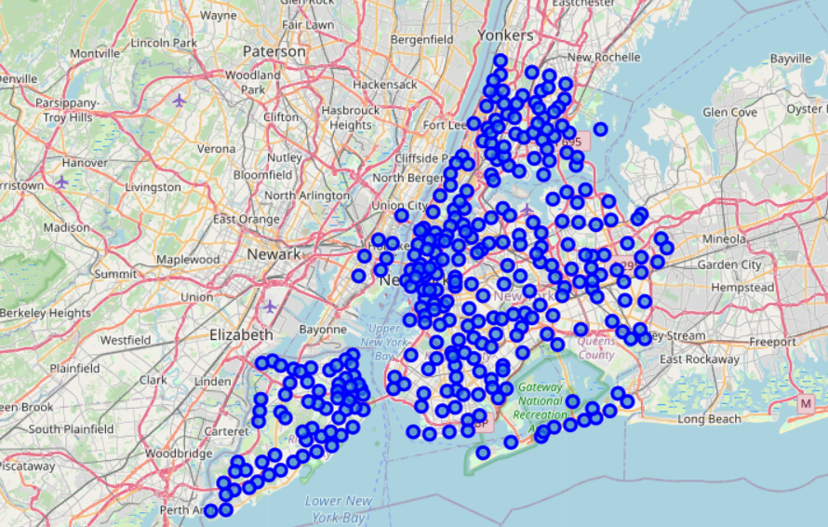
Data Sources
Venue data for New York City from Foursquare.com.
Venue categories definition data from Foursquare.com.
New York Neighborhoods Latitude and Longitude data from Class Lab - Segmenting and Clustering Neighborhoods in New York City.

Slide 4
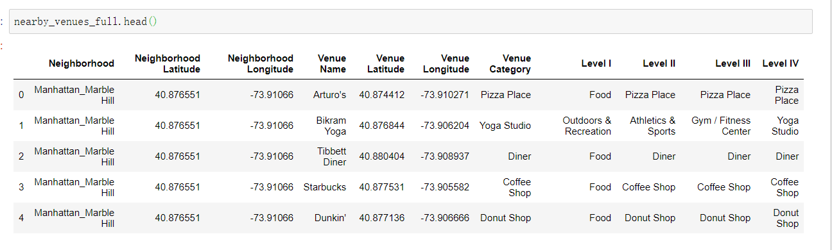
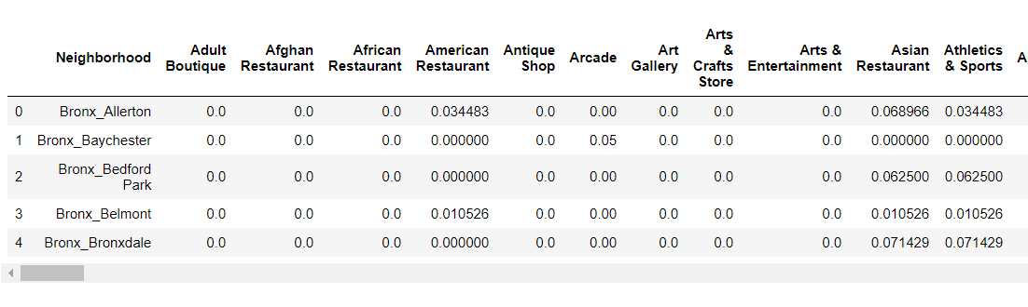
Data Cleaning
1. Merge the venue category table with original venue data table to retrieve the higher-level (level 1-3) venue information for each row of the original venue data.
2. Reformat the venue data for each neighborhood using one hot encoding, then aggregate the venue data within each of the neighborhood by taking average (the reformatting is performed on Level II)

Slide 5
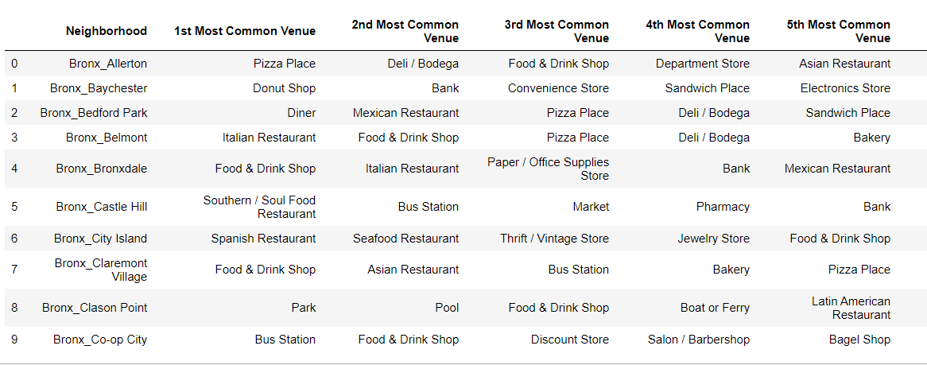
Most Popular Venue in Allerton
We will take Allerton as an example in our study.
The most popular venue in Allerton is Pizza Place
But that does not mean the opening a pizza place is the best choice for new business in Allerton as there might be already too many pizza places in Allerton.

Slide 6
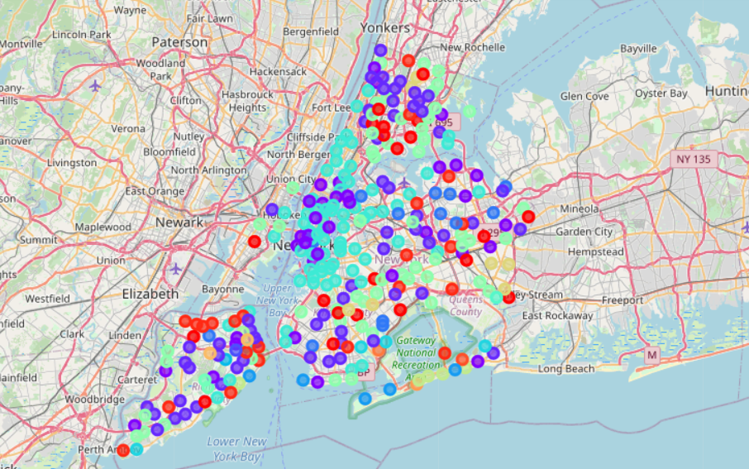
Comparing with Other Similar Neighborhoods - Clustering
To perform a more comprehensive analysis, let’s take a look at other neighborhoods that are similar to Allerton so we would have more data to analyze.
In order to find the other neighborhoods that are similar to Allerton, we will perform an unsupervised clustering analysis using the K-Means algorithm.
We will start with K = 20

Slide 7
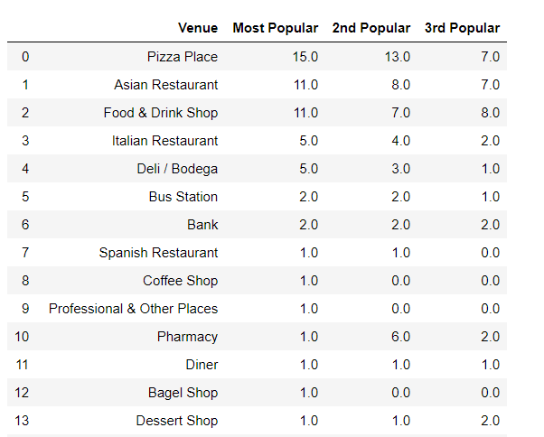
Most Popular Venue in the Entire Cluster that Allerton Belongs to
There are 60 neighborhoods that are grouped into the same cluster as Allerton.
Pizza place is indeed the most popular venue category with in the neighborhoods that are similar to Allerton, followed by Asian Restaurant.

Slide 8
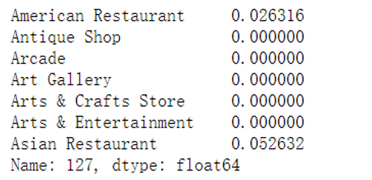
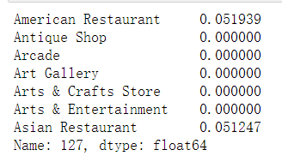
The Business that Allerton Needs the Most: sensitivity test on each venue
Let’s view the problem in a different way: what new business/venues does Allerton need the most?
We can solve this problem using the intra-cluster similarity of the cluster and Allerton belongs to.
We will perform a sensitivity analysis on each of the venue category in Allerton by a positive shock of +1 (assuming we will start a venue).
For example, for the sensitivity on American restaurants, we will just add one more American restaurant to the count of American restaurants. That will slightly change the distribution of the venue categories in Allerton.
Original distribution of venue categories
Post-shock distribution of venue categories
Shock the venue “American Restaurants” by adding one more American restaurant to Allerton

Slide 9
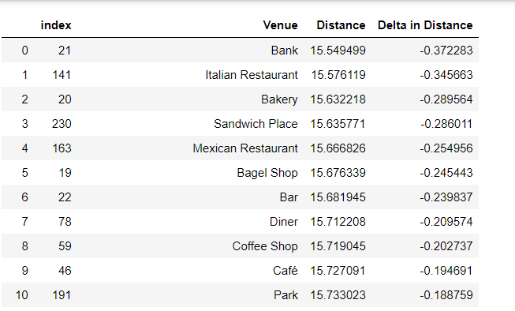
The Business that Allerton Needs the Most: intra-cluster similarities
For each shock. an increment in the intra-cluster similarity means that by starting a new business in that venue, Allerton is getting more similar to other neighborhoods in the same cluster, which means that venue is what Allerton needs.
We will repeat the above shocking-testing process on all of the venue categories, and the one result in the largest increment of intra-cluster similarity is the venue category that Allerton needs the most.
We will calculate the intra-cluster similarity using the distance matrix. Note that they are inversely correlated: higher distance means lower similarity.

Slide 10
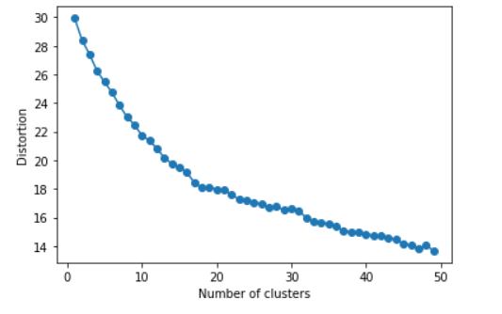
Different choices of K in K Means
Let’s take a look at the clustering performance with different K.
Unfortunately, we were unable to find any clear elbow point.
In such scenario, in order to improve the robustness of our model, we will repeat the above analysis for all choices of K, then aggregate the results.

Slide 11
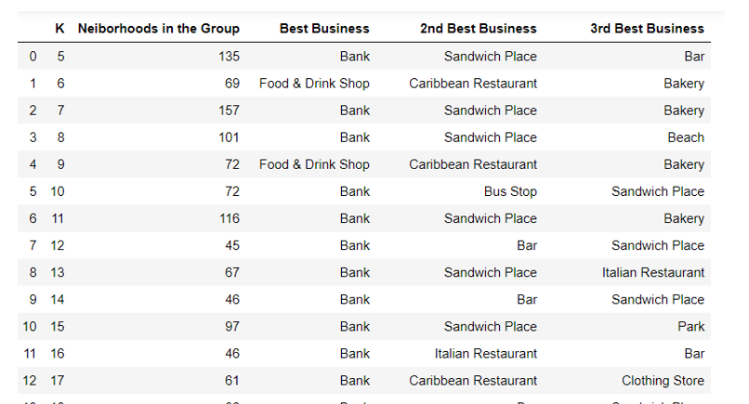
The Best Business Estimated by K Means with Different K (K = 5 to 40)

Slide 12
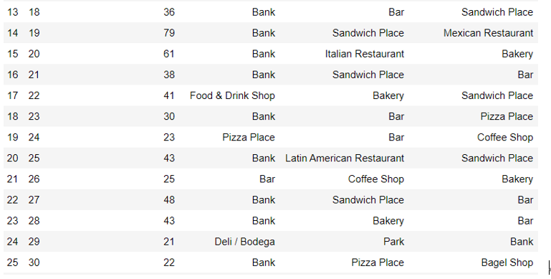
The Best Business Estimated by K Means with Different K (K = 5 to 40) Cont.

Slide 13
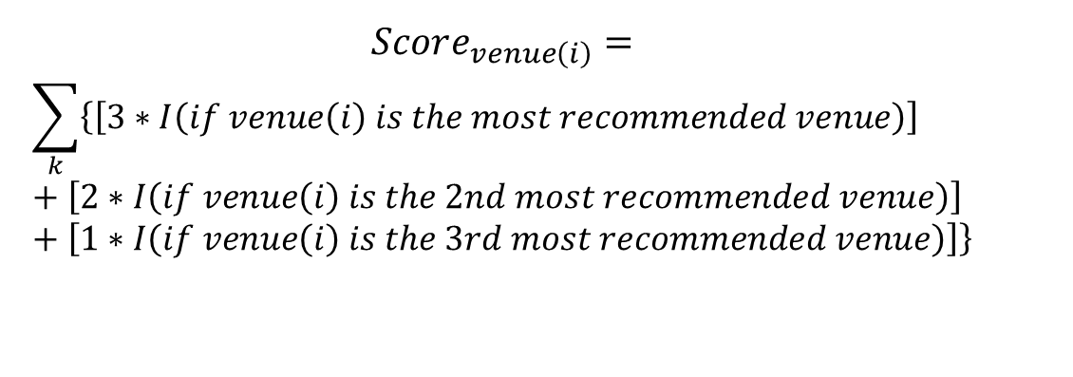
Final Scores
The outcomes on the last two pages (most recommended venue categories) are overall quite stable with different Ks.
Now we aggregate the results above by summing over different Ks. Let’s define a score for each venue category:
$$Score_{venue\left(i\right)}=$$
$$\sum_{k}{\left\{\left[3∗I\left(if venue\left(i\right) is the most recommended venue\right)\right]+\left[2∗I\left(if venue\left(i\right) is the 2nd most recommended venue\right)\right]+\left[1∗I\left(if venue\left(i\right) is the 3rd most recommended venue\right)\right]\right\}}$$

Slide 14
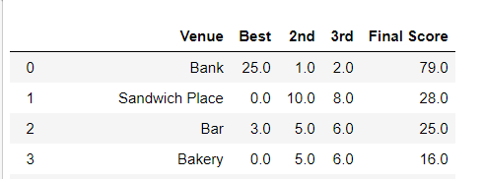
Results
The top 4 best choices for new business in Allerton are Bank, Sandwich Place, Bar and Bakery.
In particular, Bank is the top one choice, with its score much higher than all other venue categories.
There is currently no bank in Allerton, while there are banks in most of its similar neighborhoods. Therefore, bank is indeed one of the most needed business in Allerton – the output of our model is consistent with intuition.

Slide 15
Conclusions
According to the summary table on the last page, we found the top 4 best choices for new business in Allerton are Bank, Sandwich Place, Bar and Bakery.
In particular, Bank is the top one choice, with its score much higher than all other venue categories.
Of course, opening a bank is not a practical choice to most people. Therefore, the top three best choices of new businesses in Allerton would be Sandwich Place, Bar and Bakery.
In addition, the fact that bank is the most needed business in Allerton is quite useful information -- it might be a good choice for banks to open a branch in Allerton

